Slide 1
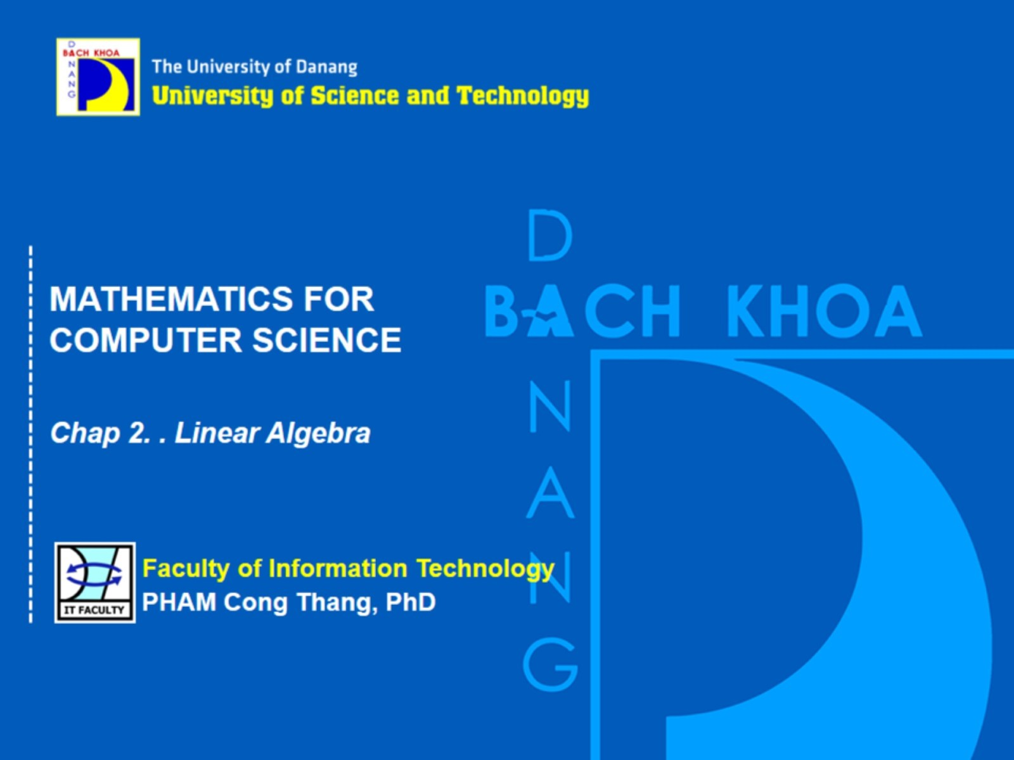
Mathematics for Computer Science

Slide 2
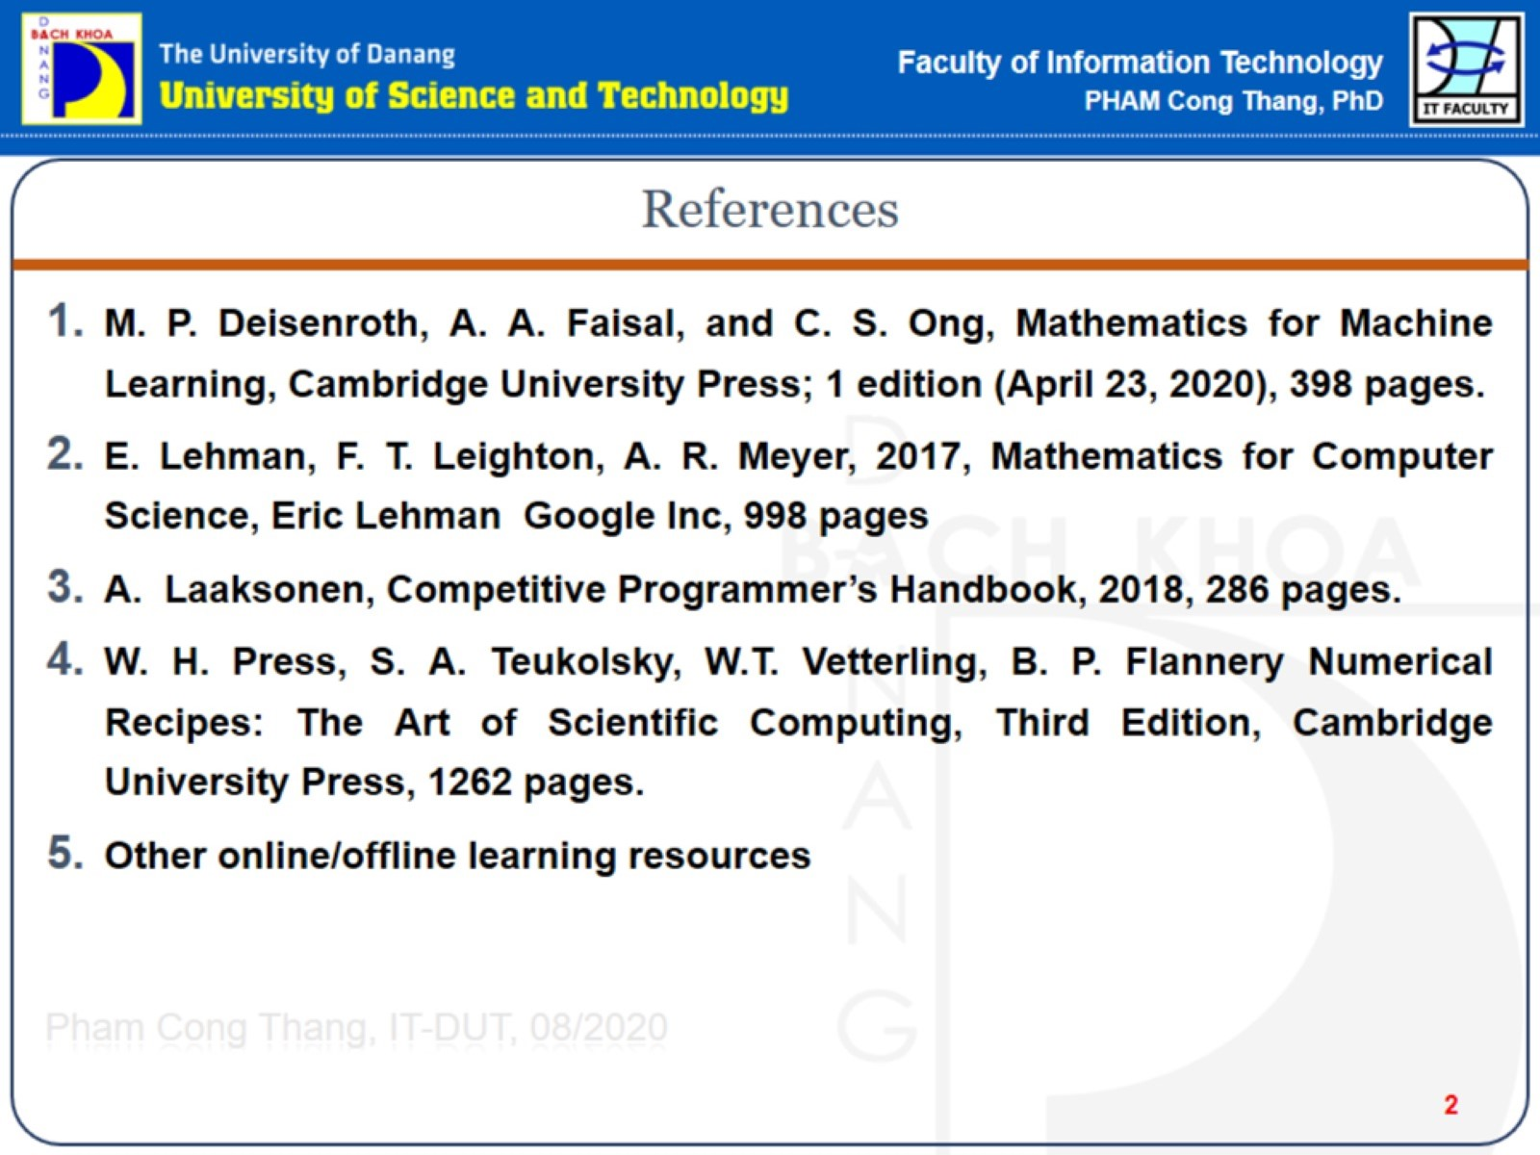
References

Slide 3
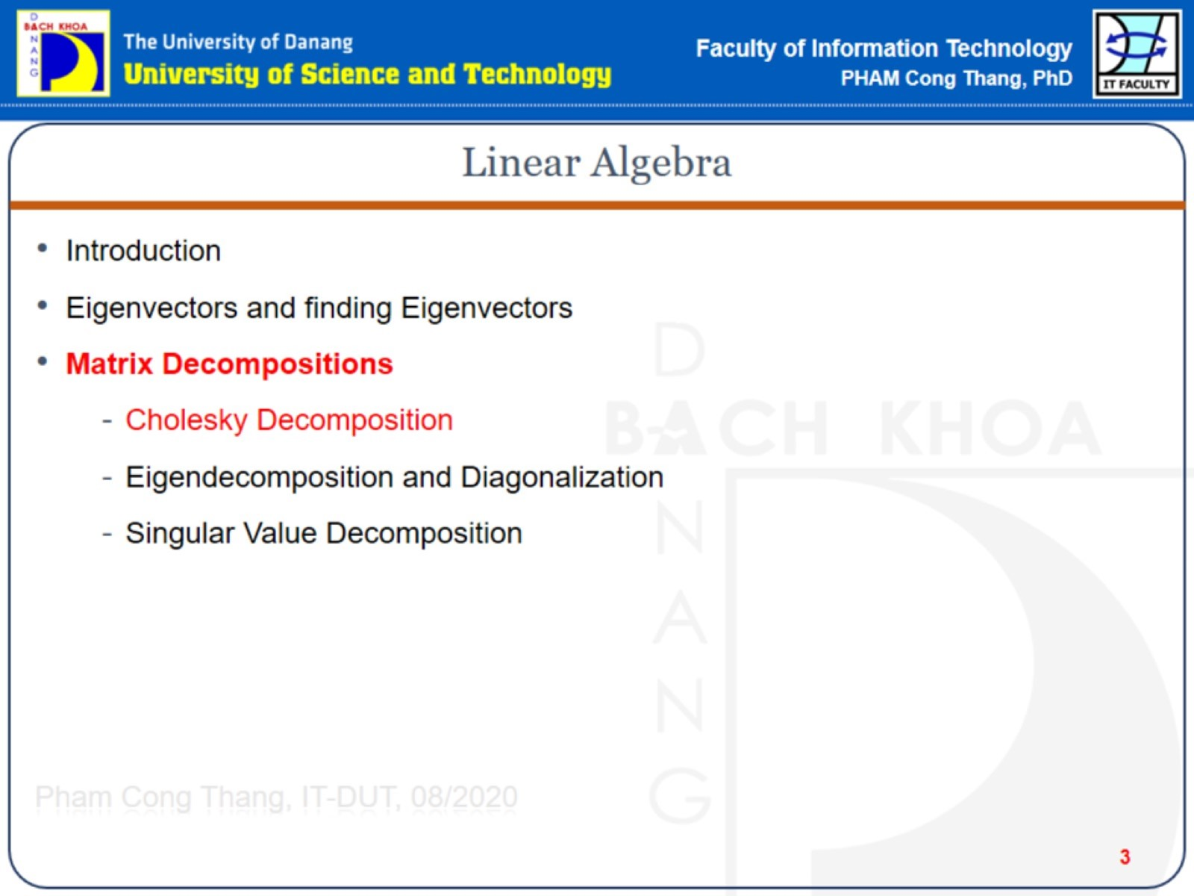
Linear Algebra

Slide 4
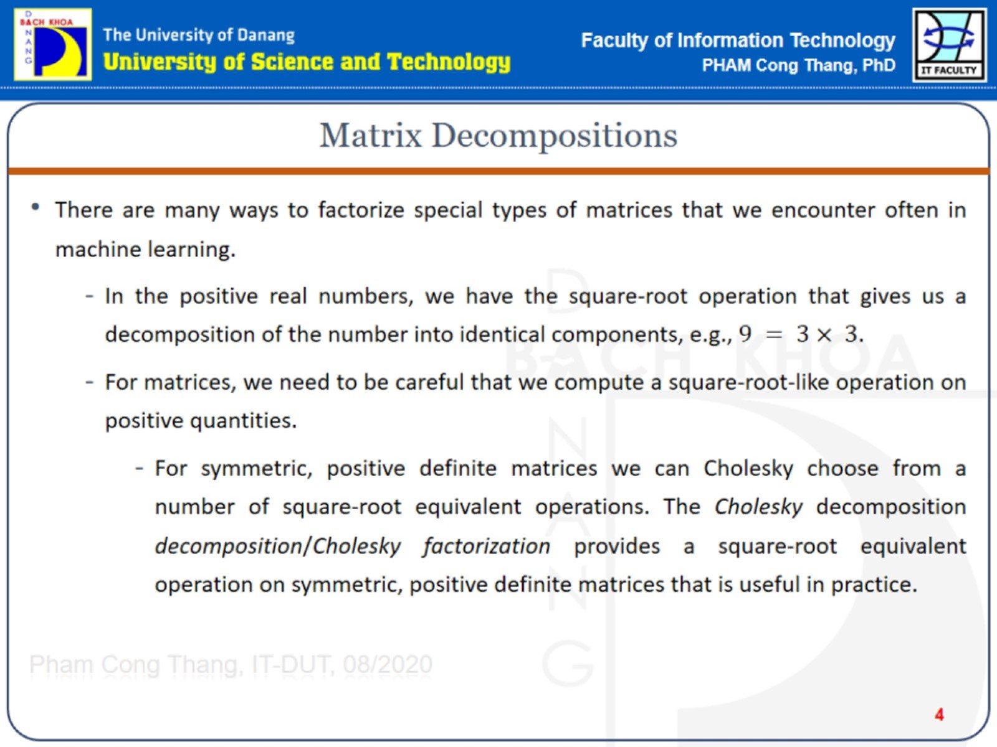
Matrix Decompositions

Slide 5
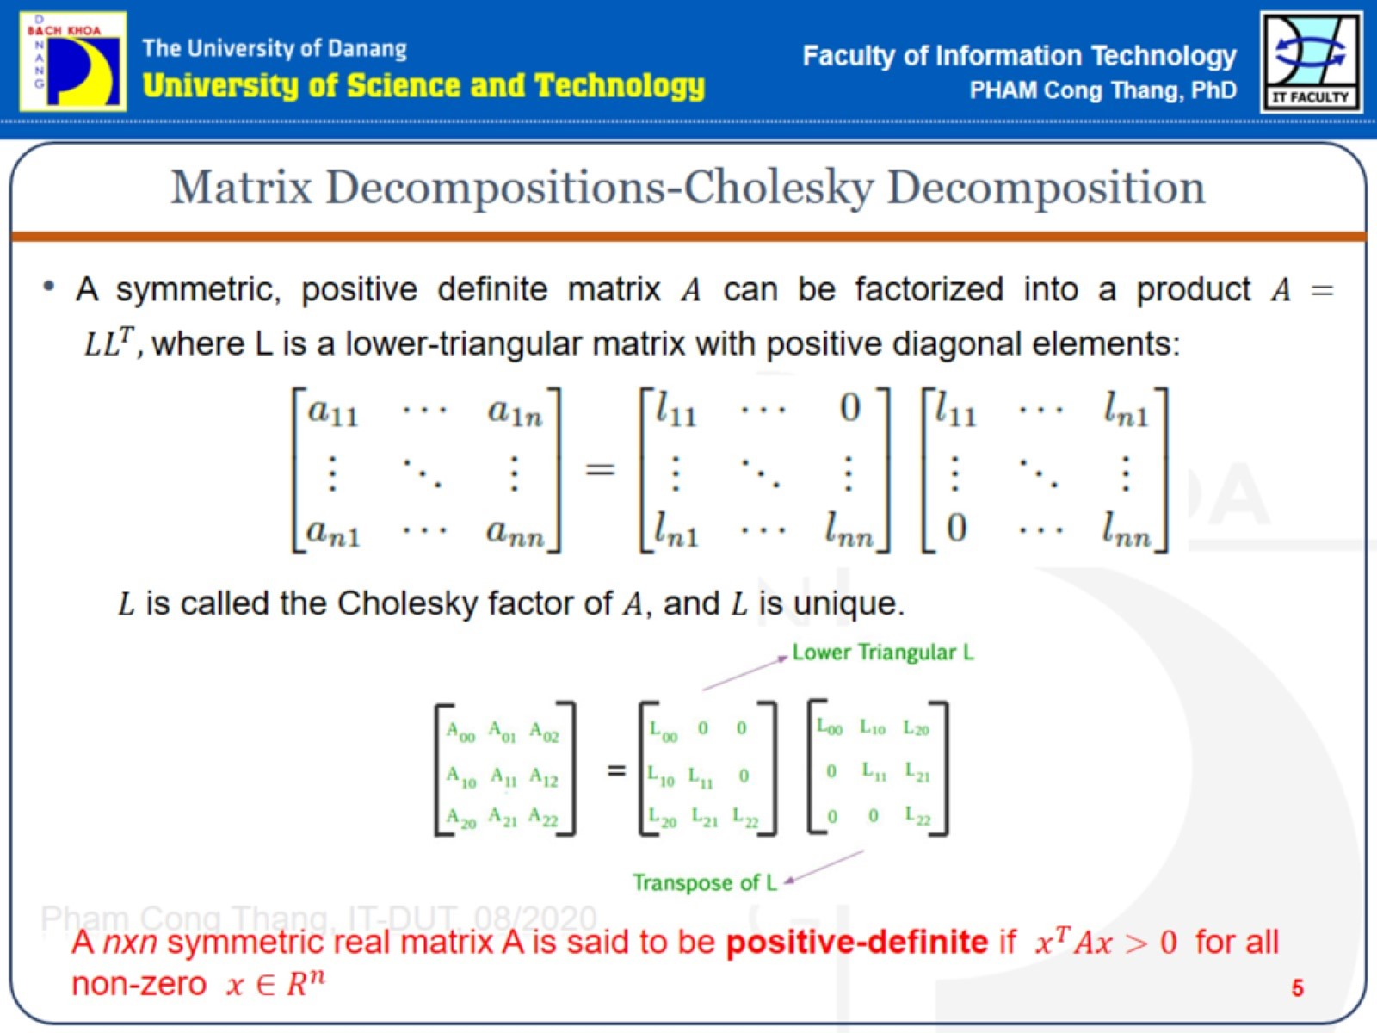
Matrix Decompositions-Cholesky Decomposition

Slide 6
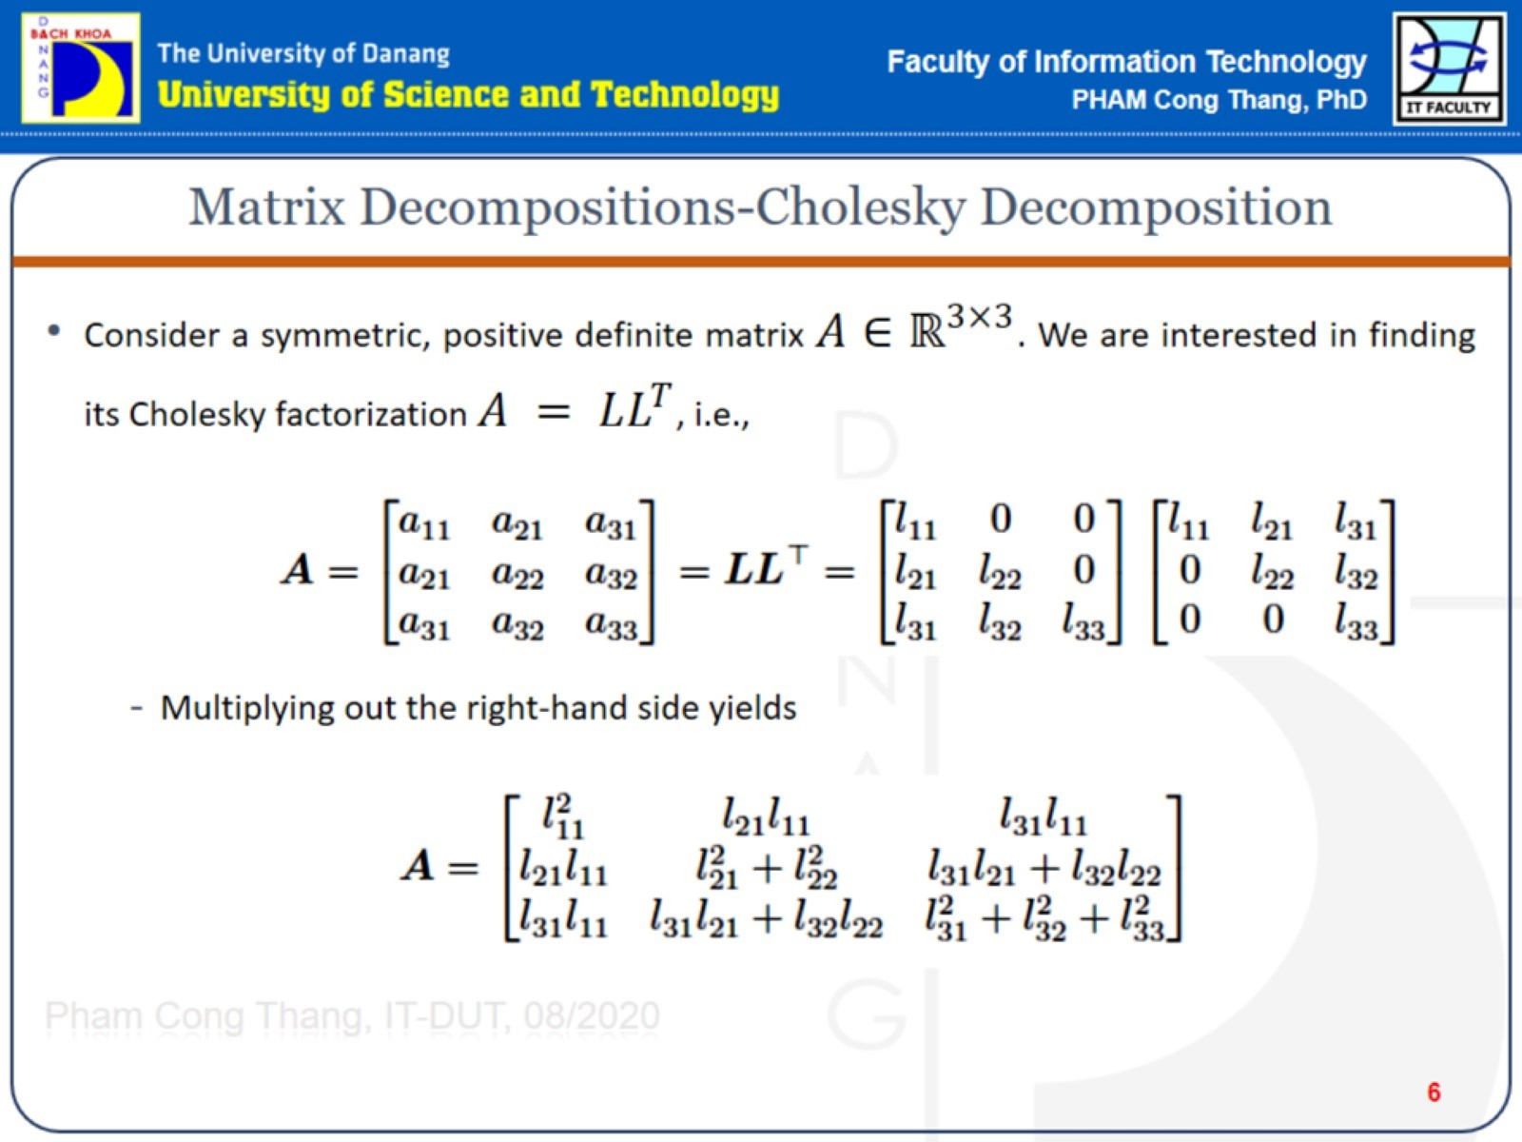
Matrix Decompositions-Cholesky Decomposition

Slide 7
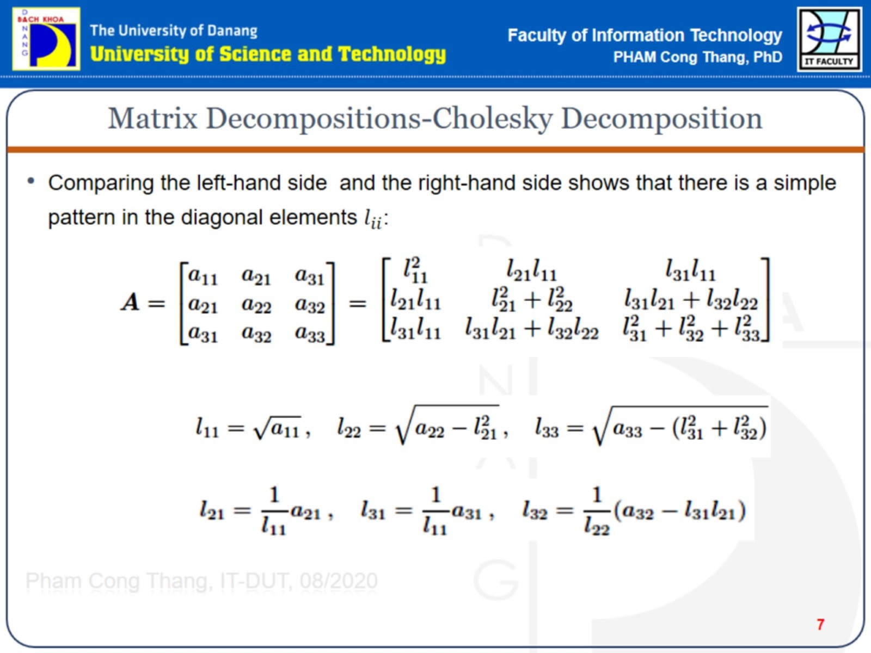
Matrix Decompositions-Cholesky Decomposition

Slide 8
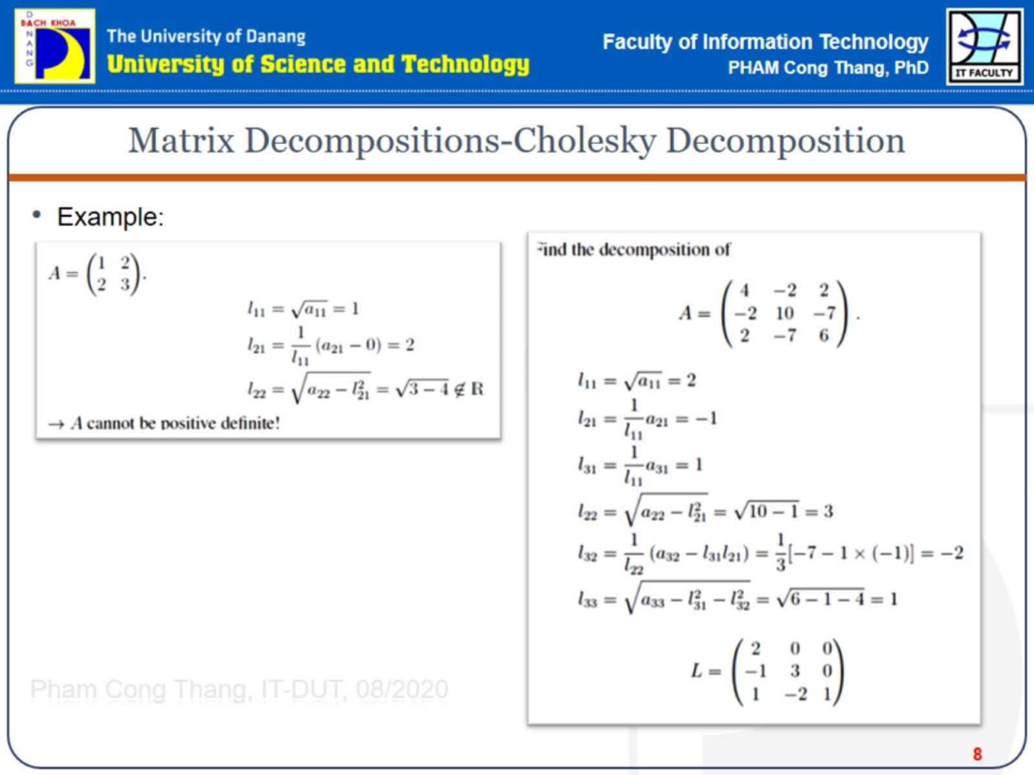
Matrix Decompositions-Cholesky Decomposition

Slide 9
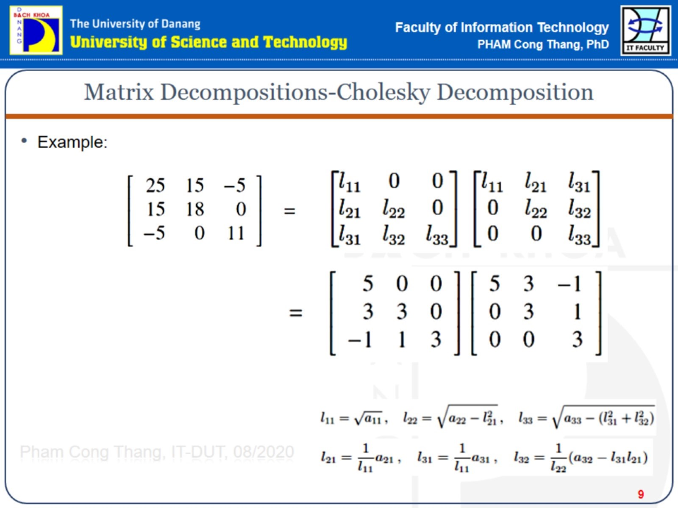
Matrix Decompositions-Cholesky Decomposition

Slide 10
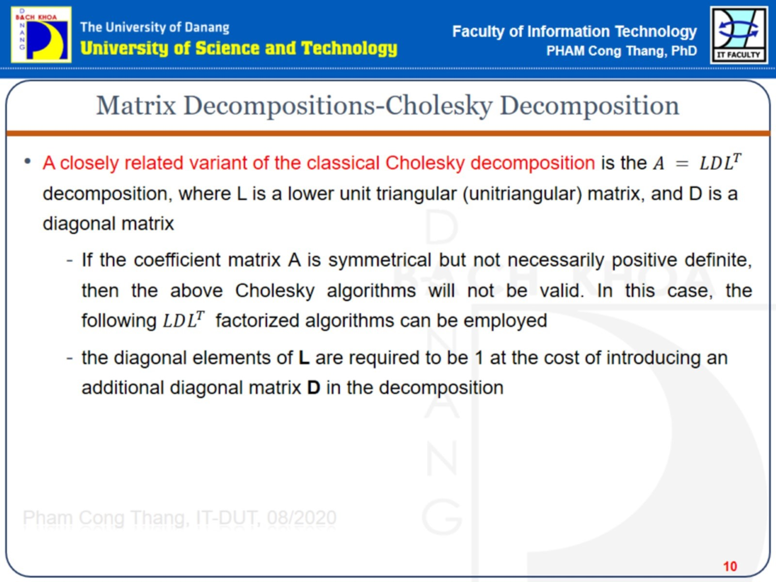
Matrix Decompositions-Cholesky Decomposition

Slide 11
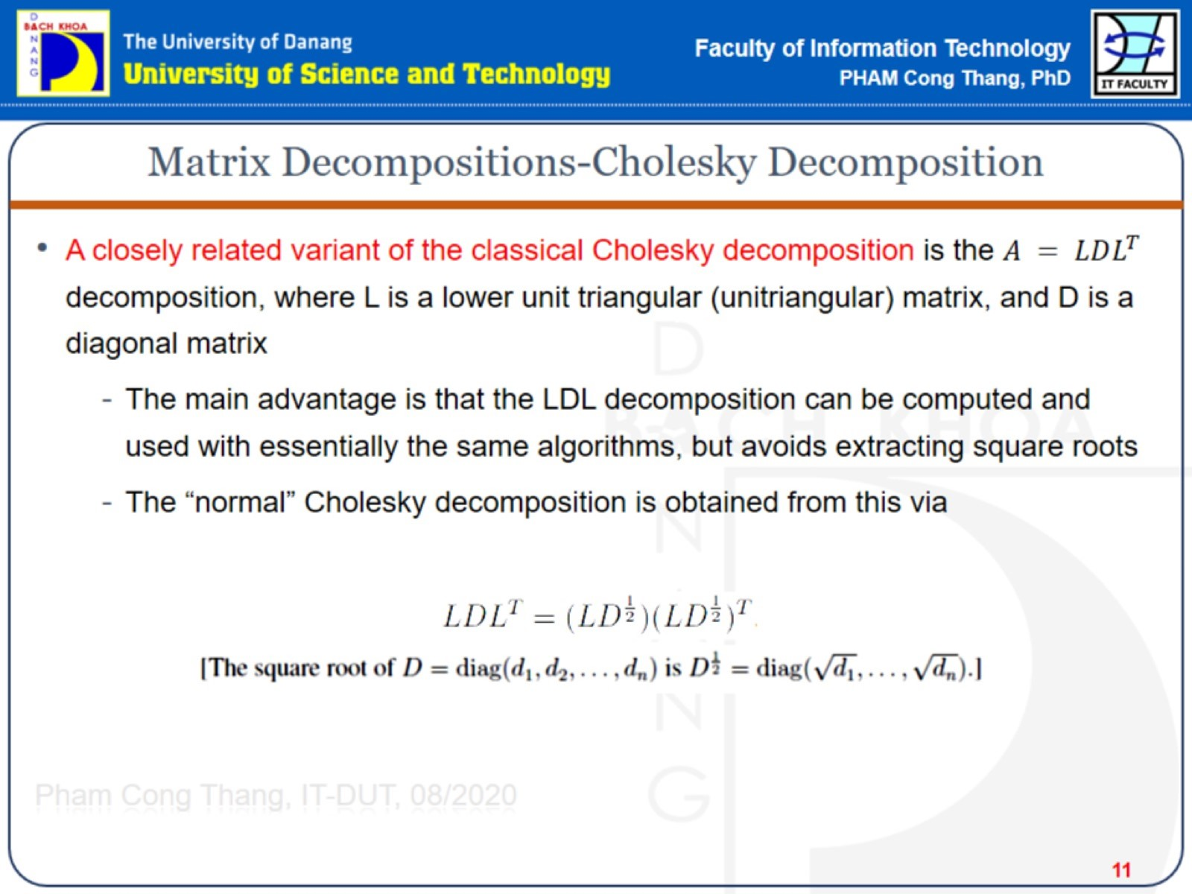
Matrix Decompositions-Cholesky Decomposition

Slide 12
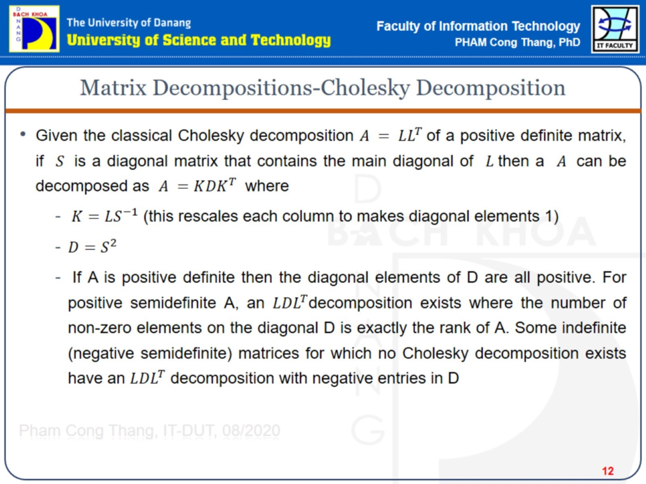
Matrix Decompositions-Cholesky Decomposition

Slide 13
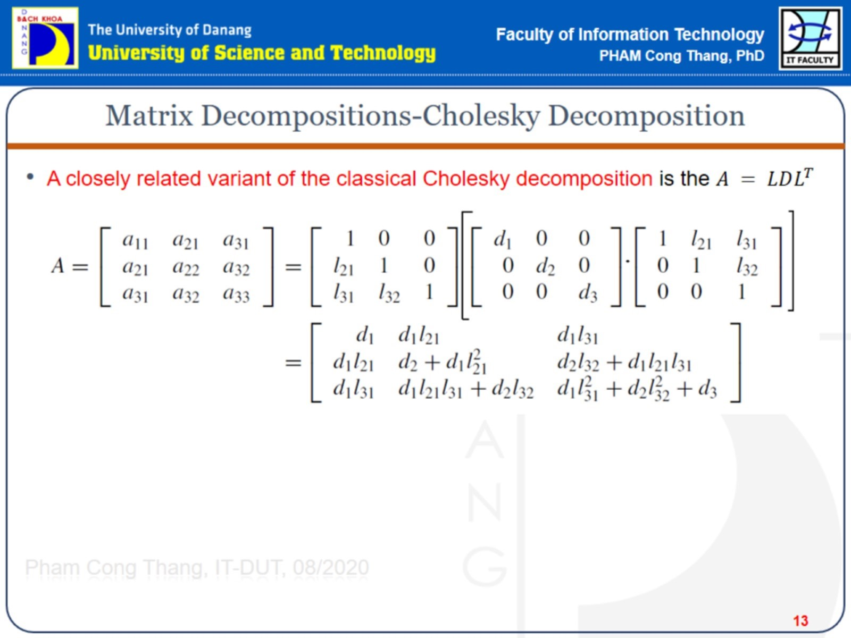
Matrix Decompositions-Cholesky Decomposition

Slide 14
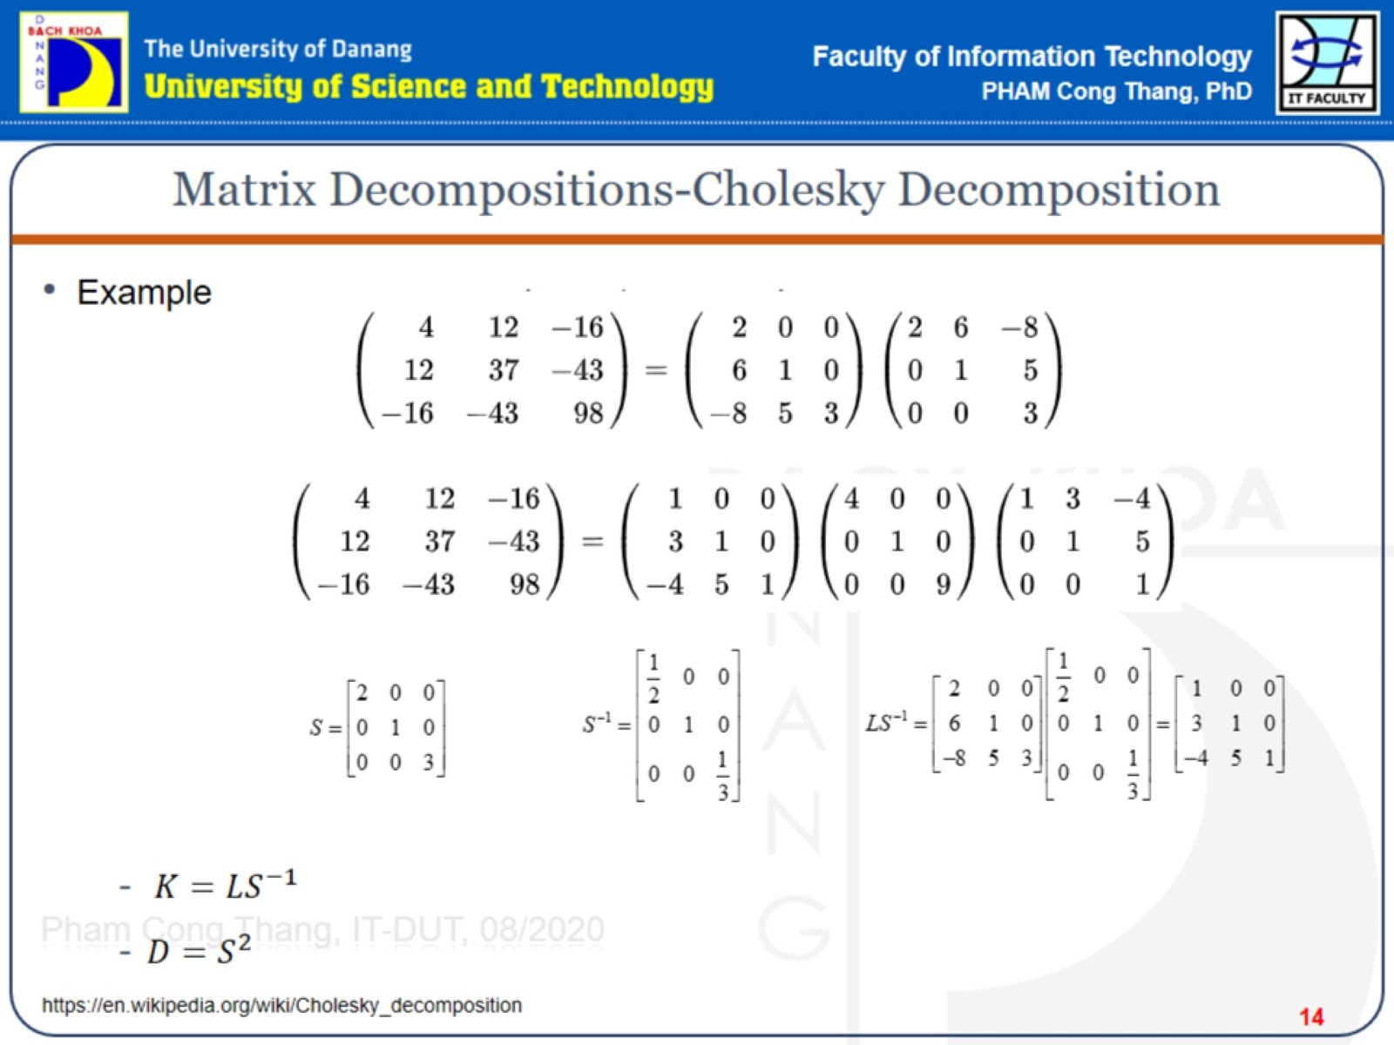
Matrix Decompositions-Cholesky Decomposition

Slide 15
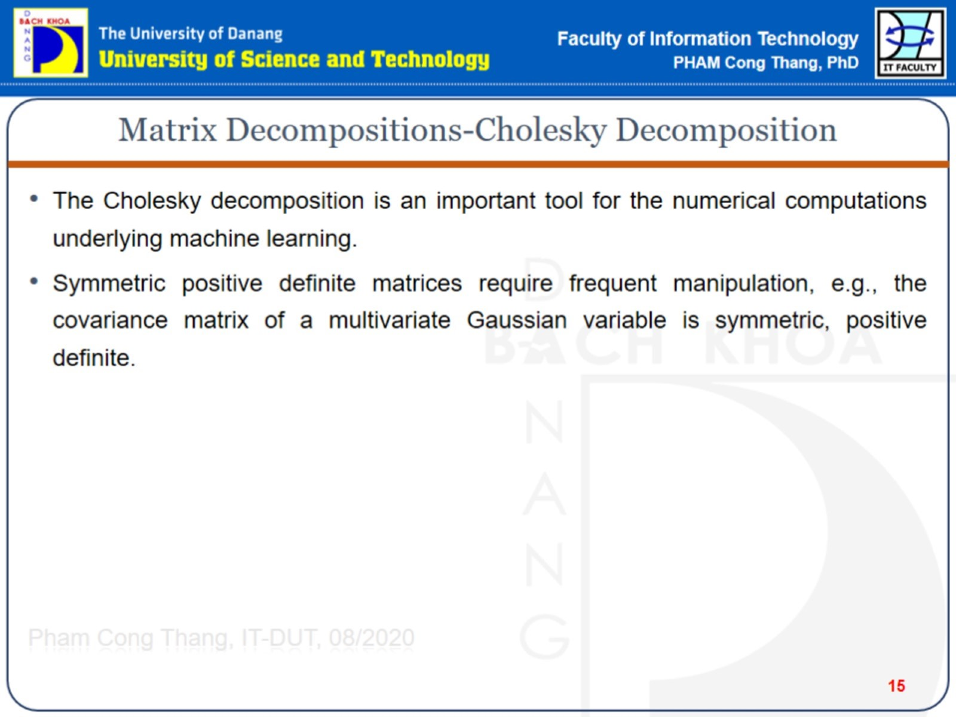
Matrix Decompositions-Cholesky Decomposition

Slide 16
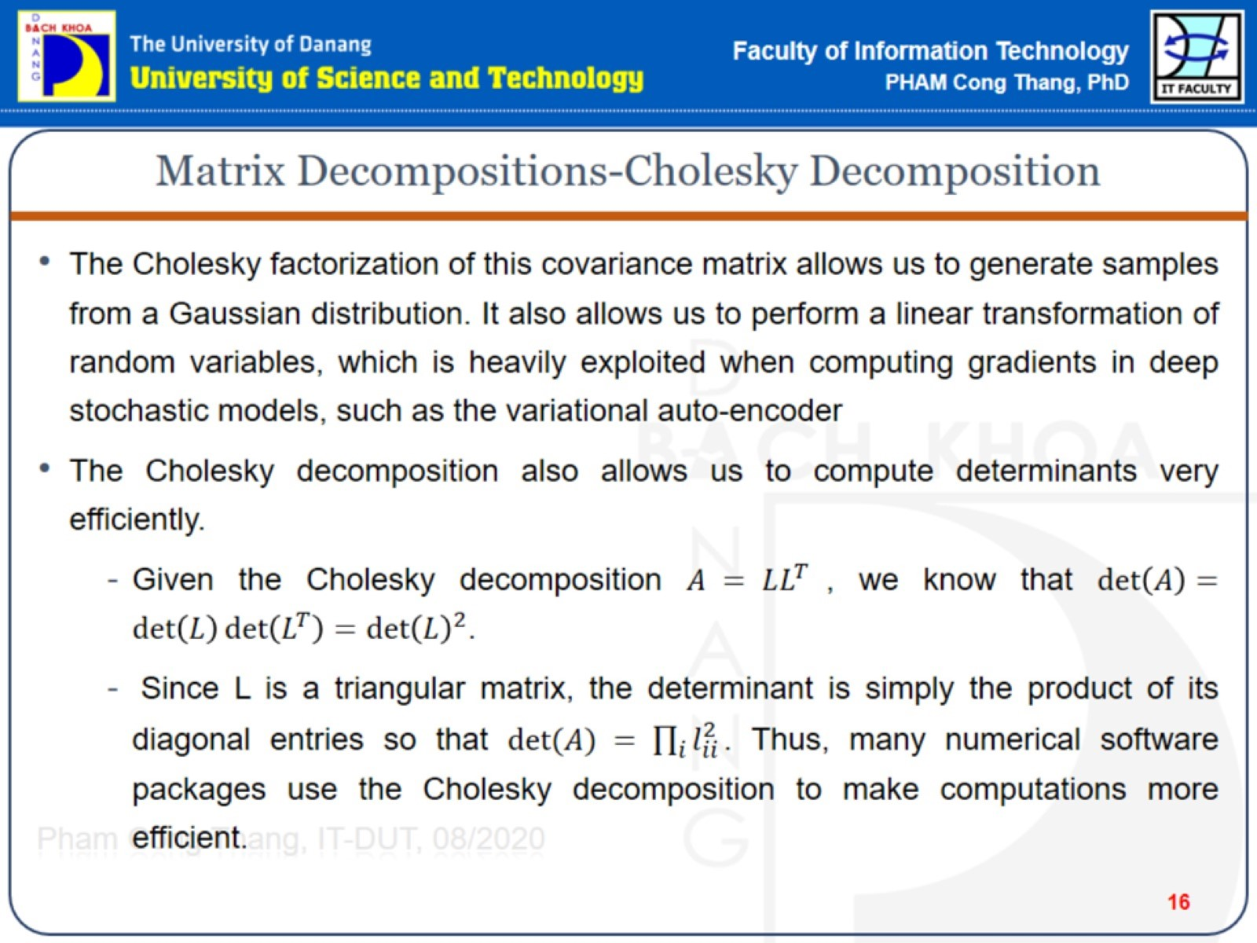
Matrix Decompositions-Cholesky Decomposition

Slide 17

Linear Algebra

